Slide 1

Establishing a Value-Driven Model for Healthcare

Slide 2
Proposal
Introduce a new approach for measuring the value of healthcare (using a patient-driven model)
To provide a unified vision for delivering sustainable value for patients, practitioners, and providers.
To drive innovation & collaboration.
To guide continuous improvement (quality and efficiency) across the continuum of care

Slide 3



The Vision
Value
Quality
Practitioner-Driven
Results
Provider-Driven
Patient-Driven
“Health care organizations are increasingly concerned with looking beyond financial performance measures, while focusing on how to deliver higher quality care “
- Love, Dianne, Revere, Lee, and Black, Ken. (2008), Journal of Health Care Finance

Slide 4
Needs of the Patients
To have affordable healthcare.
To have attainable healthcare.
To have more accessible healthcare.
To have consistent levels of quality (results).
To receive a total healthcare experience:
Ensure their functional outcomes are met.
Ensure their emotional outcomes are met.
Ensure their spiritual outcomes are met.
Ensure their outcomes are met across the continuum of care (hospital, clinics, home, and nursing care).
“We continue to pay for lots of medical procedures that don't add to health value and in fact just add costs to the system..”
- Kathleen Sebelius

Slide 5
Needs of the Practitioners
To improve diagnostic capabilities in a cost-effective manner.
To improve clinical processes.
To provide consistent levels of quality.
To move beyond service, where they can deliver a positive experience.
To be able to reliably measure value for their patients, for themselves as individual practitioners , and for the providers.

Slide 6
Needs of the Providers
To get alignment amongst the hospitals, nursing homes, and home care providers on measuring value from a patient perspective.
To increase collaboration NOT competition.
To understand how to identify, measure and deliver value as patients flow through the continuum of care.
To help reduce the overall costs of healthcare while improving the overall value for patients and practitioners (where value is created).

Slide 7
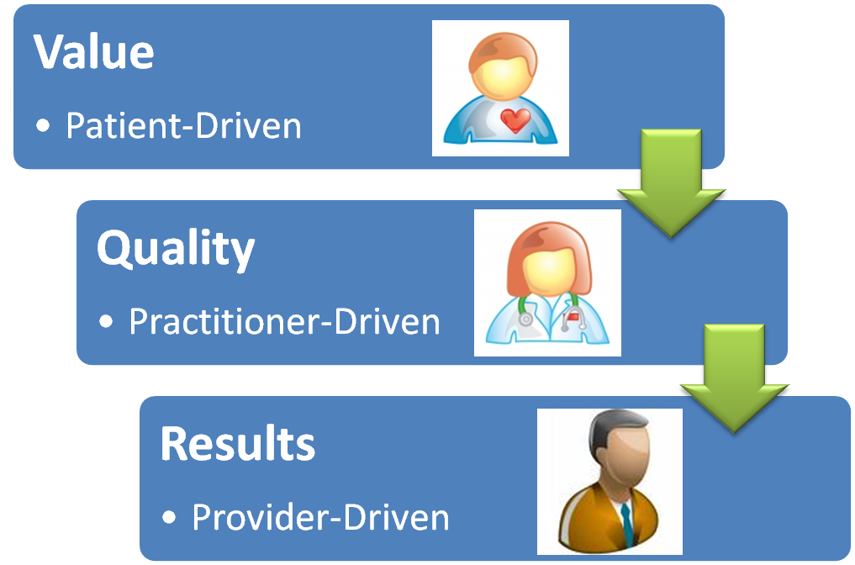

Value-Driven Healthcare Model
Providing Patients with a way to measure the value they should be receiving for healthcare throughout the continuum
Guiding Practitioners to measure and optimize the value they deliver to Patients
Guiding the Providers to deliver value to Patients & Practitioners

Slide 8
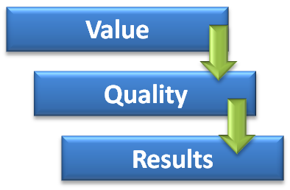
Moving from Assumptions to Implementation
Establish a program focused on mapping the Jobs & Outcomes across the healthcare domain.
Build a portfolio of unmet needs (opportunities) for improving value delivery to patients and practitioners.
Establish a prioritization model to direct resources in an efficient manner.
Create an open innovation framework using the opportunities to generate ideas that can address the most important (prioritized) unmet needs.
Align healthcare measurements (Quality = TQM, Evidence-Based = EBM) with value-driven measurements (VDM) to align information and optimize continuous improvement.

Slide 9
Measuring Value for Healthcare
Build a portfolio of jobs & outcomes:
For measuring value *
For driving innovation
For directing efforts to improve quality
For guiding initiatives to reduce cost
* Value is created between the Patient & Practitioner

Slide 10
Enabling Value for Healthcare
Value-Driven Healthcare Platform
Technology
Ideas
Resources
Innovation
Value Measurement
New Concepts
New Products & Services
New Value Delivery
Outcomes
Compliance
Quality & Efficiency
Value-Driven metrics are used to drive innovation & direct Quality & Efficiency

Slide 11
Future Opportunities
A program focused on mapping the Jobs & Outcomes across the healthcare domain.
A portfolio of unmet needs (opportunities) for improving value delivery to patients and practitioners.
A prioritization model to direct resources in an efficient manner.
An open innovation framework using the opportunities to generate ideas that can address the most important (prioritized) unmet needs.
A shared revenue model as part of a collaborative to address unmet needs.

Slide 12
If you are interested in obtaining more information about our services, please visit us online or contact us directly.
Online: www.enablingvalue.com
Phone: (847) 261-IDEA
Email: jeffrey.wallk@enablingvalue.com

